Slide 1
BREAULT SWD TRAINING
Date: Sept 16th, 2024
Attendance: John chu, tom Brixey, jon Herlocker, and pam james
Goal: Explain how to in’s and out’s of github in breaultswd org.

Slide 2
Github navigation
Briefly before we navigated through GITHUB. This serves as a refresher.

Slide 3
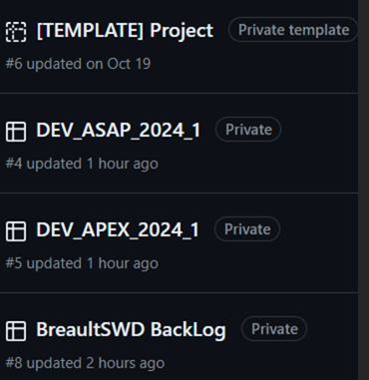
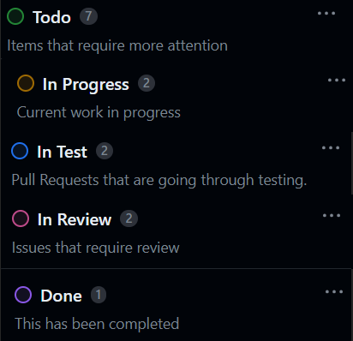
Projects

Slide 4
Repository
Only the DEV_ repo’s shall have Issues associated.
No development shall be done directly on the BreaultSWD repo’s
All development shall be on forks
All test cases shall be in associated Test_Repo

Slide 5
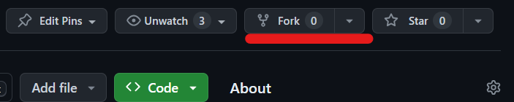
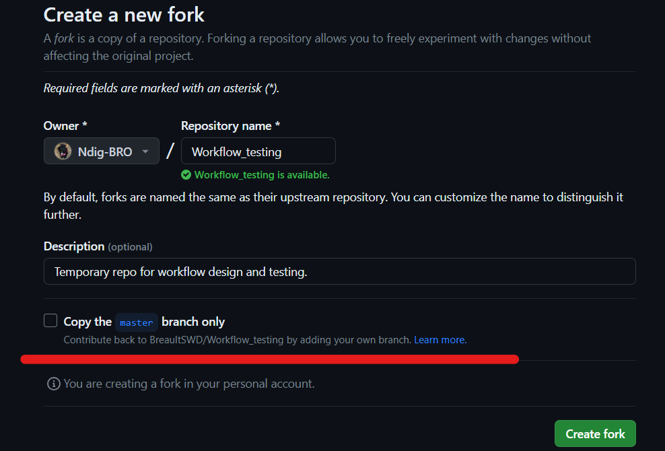
Creating a new fork

Slide 6
Issues
Shall be from the back-log
Shall be associated to a DEV_ project
Shall be created on a DEV_ branch
Developer cannot close out issue without review
The reviewer shall close out the issue
Development shall be linked with a pull-request

Slide 7
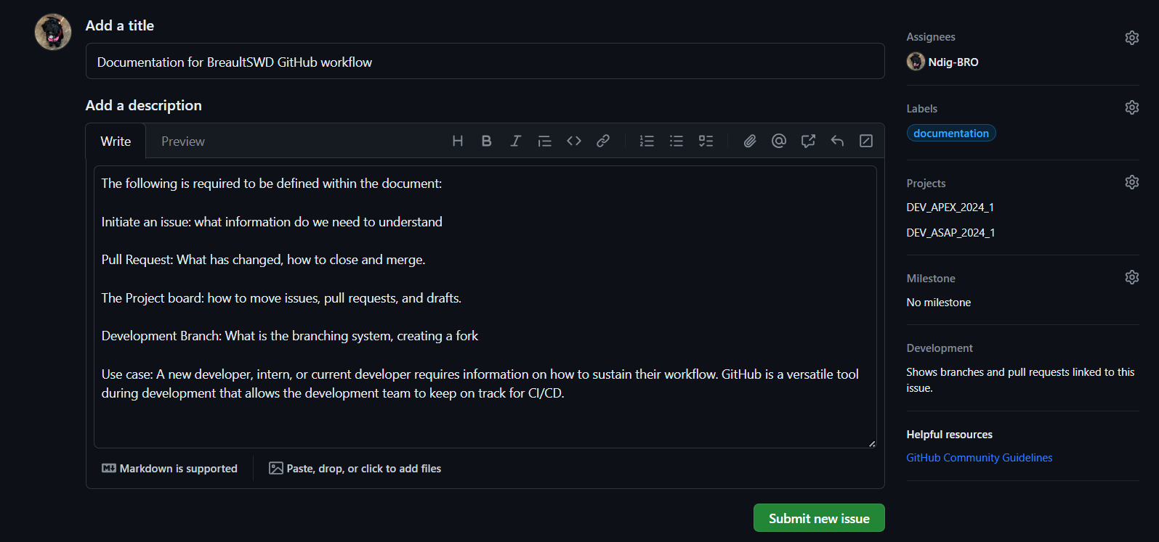
Issues

Slide 8
Obtaining the codebase bash files

Slide 9
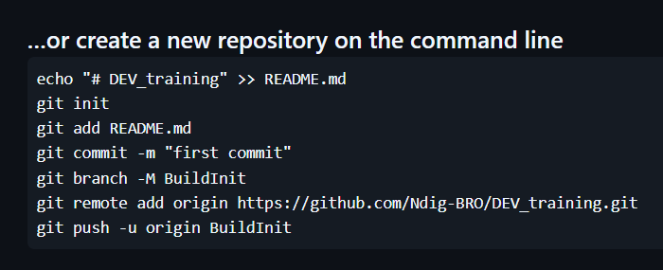
Commits in bash
git init -b <name of the local branch>
Git checkout -b <name of branch>
Add the files to your current local Branch:
git add .
git commit -m “<DEV_note>”
git remote add <name> <URL fork link>
git push <remote> <branch>

Slide 10
Commits in git gui

Slide 11
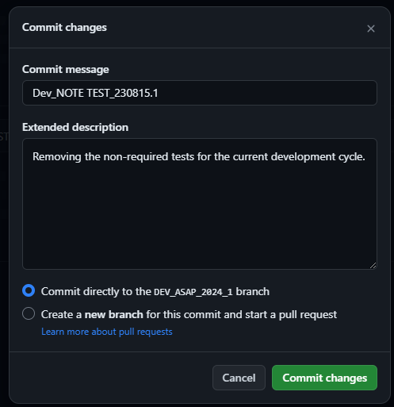
Commits in github

Slide 12
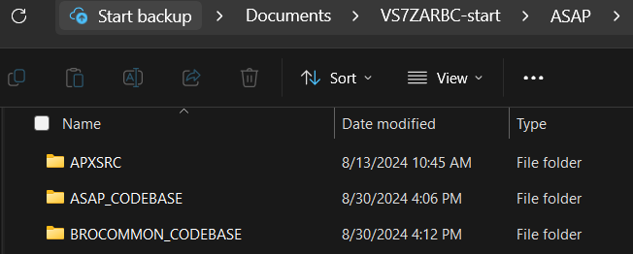
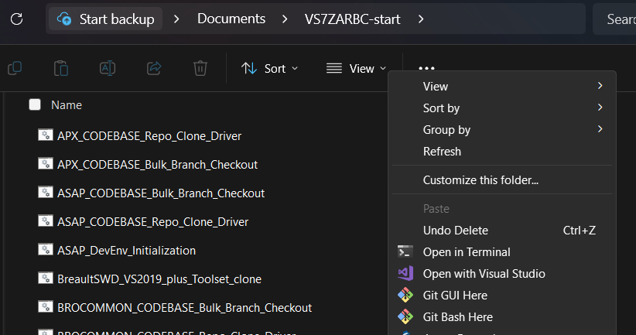
Bash scripts to call for every dev
Delete the files within and keep the main folders
From VS7ZARBC call a git bash here

Slide 13


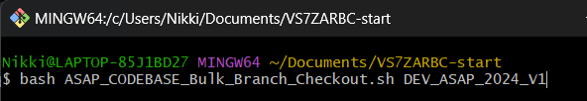

Bash scripts to call for every dev
Bash repo_clone first
Bash bulk_branch <DEV_ branch>

